Slide 1
HR DATA ANALYSIS
--IBM HR DATASET
MSBA 304 Gurui Huang & Maoyi Song

Slide 2
INTRODUCTION
General data description and data investigation on IBM HR dataset by using SQL in R and R for data visualization; suggestions are made based on data interpretation, inferences only, models and tests are needed for further conclusion or decision, which will be not included in this project.

Slide 3
TABLE OF CONTENT
About Data
Company General Information
Employment Satisfaction
Work-life Balance
Employee Promotion
Potential Risk Detection for HR department
Employees’ Behavior Tracking
References

Slide 4
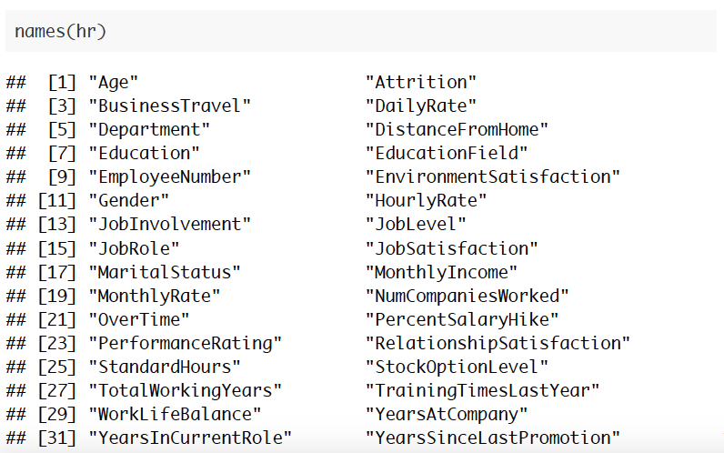
HR DATA OVERALL
The data “IBM HR. csv” is a sample of IBM human resource information data with 33 variables and 1470 observations:

Slide 5
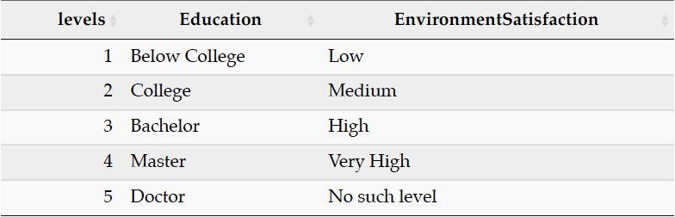
HR DATA OVERALL
Noticed that some variables scaled by number 1 to 5, let’s discovering the meaning of all scales: 1 is the lowest level where 5 is the highest level.
Data scales description

Slide 6
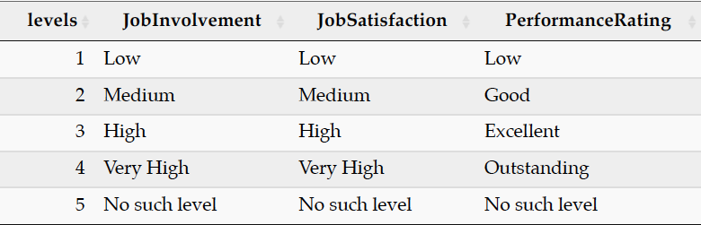
HR DATA OVERALL
Continue

Slide 7
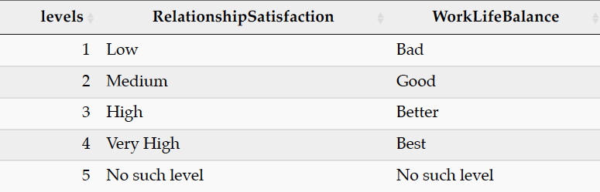
HR DATA OVERALL
Continue

Slide 8
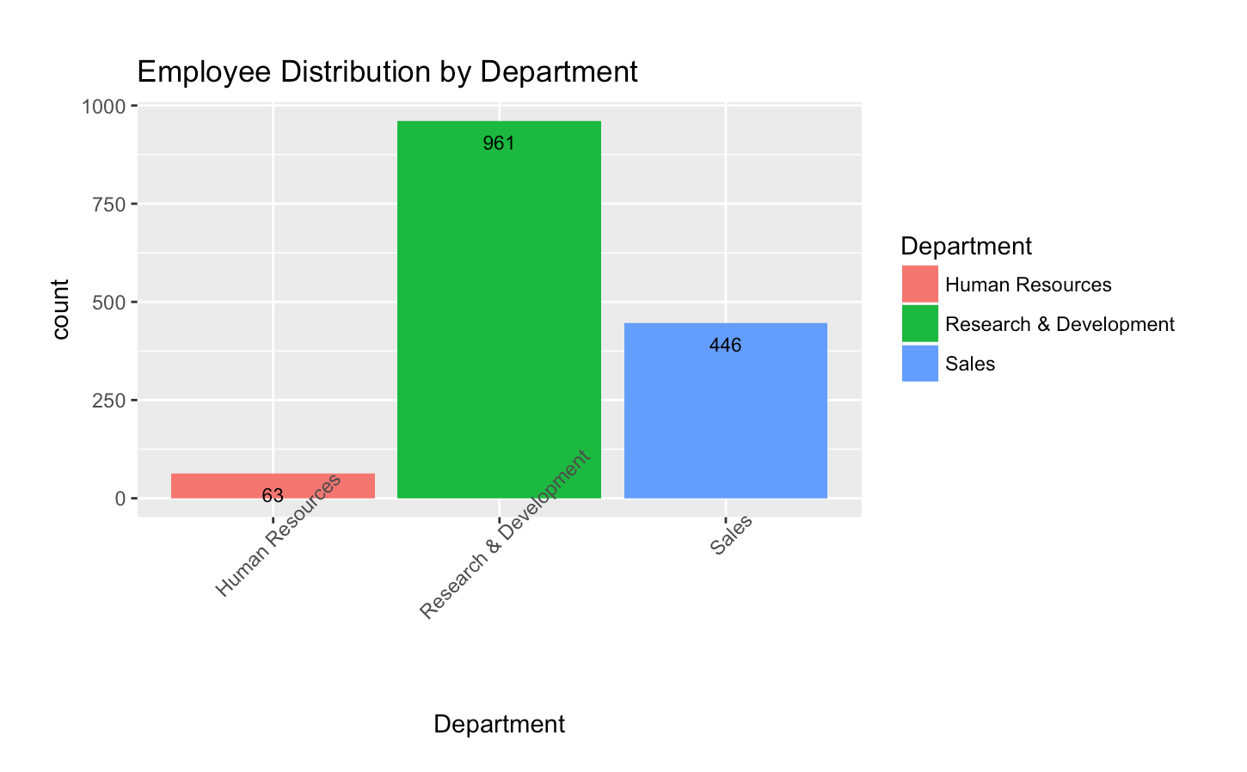
COMPANY ORGNIZATIONAL STRUCTURE
How many employee working for different department?

Slide 9
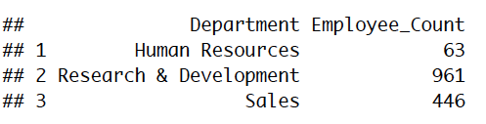
COMPANY ORGNIZATIONAL STRUCTURE
Department Overview (continued)
According to Santiago C.D, swswati L., and Gerard s. (2016), a typical but not operating model for product based and high-tech industry company, which most employees are in product team. However, this data sample may only contains only general framework of departments.

Slide 10
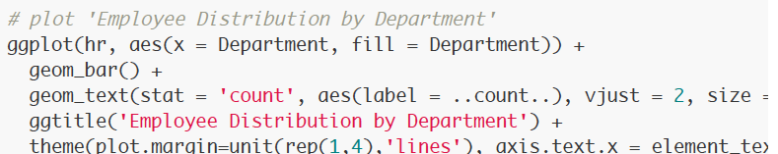
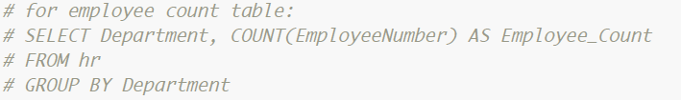
COMPANY ORGNIZATIONAL STRUCTURE
Code: R for data visualization SQL for table

Slide 11
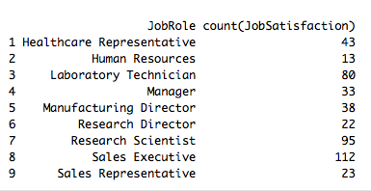
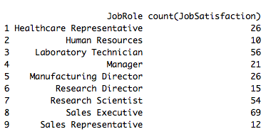
EMPLOYMENT SATISFACTION
Which role has the highest satisfaction level?
Which role has the lowest satisfaction level?

Slide 12
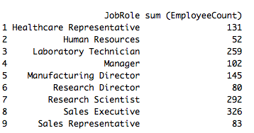
EMPLOYMENT SATISFACTION
Total Employee Number by Role
Code:
1. select JobRole, count(JobSatisfaction) from HR where JobSatisfaction=4 group by JobRole
2. select JobRole, count(JobSatisfaction) from HR where JobSatisfaction=1 group by JobRole
3. select JobRole, sum (EmployeeCount) from HR group by JobRole

Slide 13
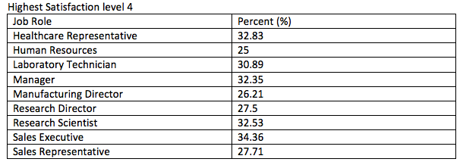
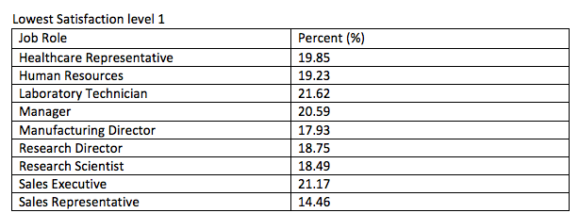
EMPLOYMENT SATISFACTION

Slide 14
EMPLOYMENT SATISFACTION CONCLUSION
Based on the result, we can conclude that the role has highest satisfaction level is Sales Executive (34.36 %), and followed by Healthcare Representative (32.83 %) and Research Scientist (32.53 %). The role has the lowest satisfaction level is Laboratory Technician (21.62 %), and followed by Sales Executive (21.17%) and Manager (20.59 %). Overall, the total number of employees who have the highest satisfaction is more than the employees who have the lowest satisfaction.

Slide 15
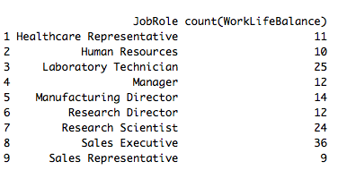
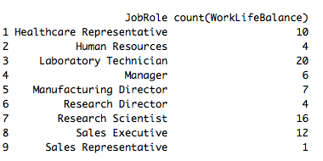
WORK LIFE BALANCE
Which role has the highest level of WorkLifeBalance?
Which role has the lowest level of WorkLifeBalance?

Slide 16
WORK LIFE BALANCE
Total Employee Number by Role (RECALL)
Code:
1.select JobRole, count(WorkLifeBalance) from HR where WorkLifeBalance=4 group by JobRole.
2. select JobRole, count(WorkLifeBalance) from HR where WorkLifeBalance=1 group by JobRole

Slide 17
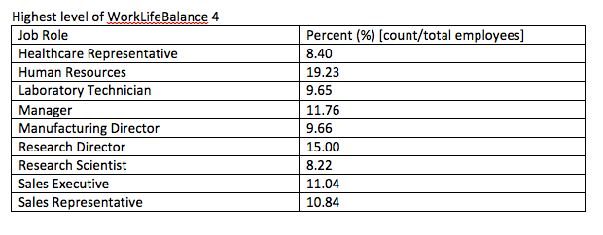
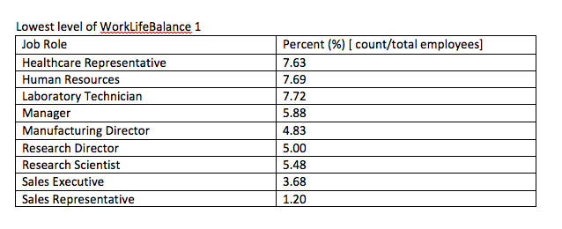
WORK LIFE BALANCE

Slide 18
WORK LIFE BALANCE CONCLUSION
The role of HR has the highest work-life balance level (19.23%), followed by research director (15%) and manager (11.76%). However, the role of HR also has the lowest work-life balance level (7.69%), compared with others. Based on the percentage, there is a big difference between 19.23% and 7.69%, so we can say most of the HR employees feel a work-life balance. Others roles, such as healthcare representative, there is a small difference between the percentage of highest work-life balance level and lowest work-life balance level. So, it indicates that we can communicate with these employees and make an improvement.

Slide 19
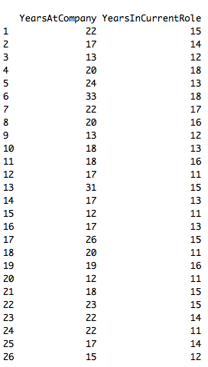
EMPLOYEE PROMOTION
select YearsAtCompany, YearsInCurrentRole from HR where YearsSinceLastPromotion > 10 and YearsInCurrentRole>10
We got 26 observations where years since last promotion is more than 10 years ago and work in the current role also more than 10 years. Also, most of the employees work for company 20 years.

Slide 20
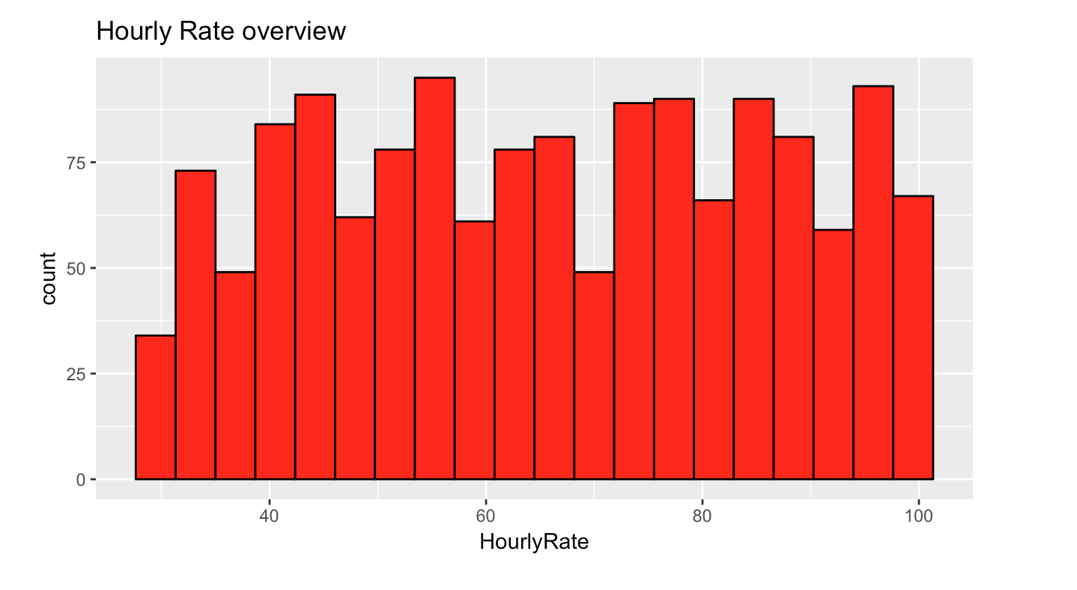
GENERAL INFORMATION OF COMPANY’S SALARY
The Hourly Rate Distribution

Slide 21
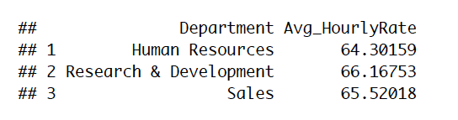
AVERAGE HOURLY RATE
The average hourly Rate by Department
Insight: Hourly rate are closed, since there is no location reference, it is not appropriate compare the results with industry level
According to Glassdoor, all industry level average of HR is around $39.59/hr and $46.875 /hr for product team. (estimated by average annual salary )

Slide 22
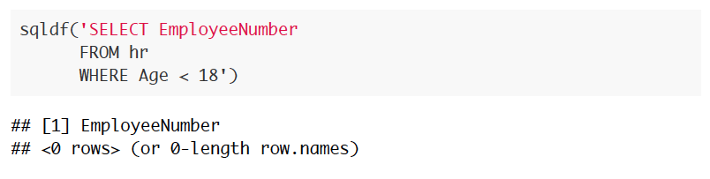
POTENTIAL RISK DETECTION FOR HR DEPARTMENT
What risk that HR department has?
Violation of Youth Rules & Violation of Equal Job Opportunity.
Check if potential risk of violation of Youth Rules:
Conclusion: NO employee under 18; no need worried about violation of youth rules.

Slide 23
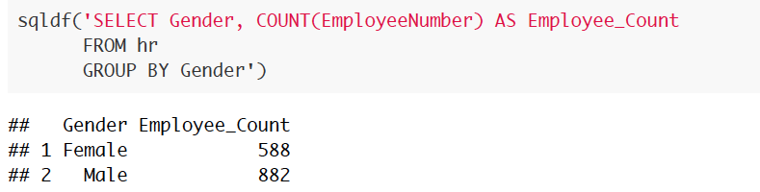
POTENTIAL RISK DETECTION FOR HR DEPARTMENT
Check if potential risk of violation of Equal Job
Insight: male-female ratio is imbalanced; according to US equal employment opportunity commission, the ratio of male-female employee itself could not be used as evidence against the company. however, for individual case, it can be used as supporting evidence.
Suggestion: need pay attention on this area to avoid disputes in the future.

Slide 24
EMPLOYEES’ BEHAVIOR TRACKING
Two major metric: Attrition and Performance.
Attrition Definition: “Employees who move, retire, pass away or leave the company to raise a family or attend school represent the usual ebb and flow of staffers through a business.(McQuerrey)”
Also, when you talk about attrition in a company, there is a similar term called employee turnover rate, which refers employees who leave the company due to termination, taking a better job, or because they felt there was no room for growth, or worse, that they were dealing with a hostile or discriminatory work environment (McQuerrey).

Slide 25
ATTRITION & EMPLOYEE TURNOVER RATE
“A high turnover rate typically means working conditions are not optimal, pay is below market average, or staffers are not well trained. Concurrently, a low turnover rate is indicative of a work environment where staffers feel appreciated, work as a team, have room to move up the corporate ladder, and are satisfied with their jobs (McQuerrey).”

Slide 26
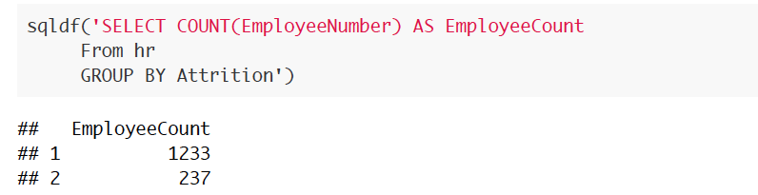

ATTRITION & EMPLOYEE TURNOVER RATE
Insight: Turnover rate in IBM company based on the data that gives us is
Based on the AON (2017), as comparison, the statistics shows that the average turnover in Software company is 22.4% , which higher than IBM.
So, it indicates that employees in the company feel appreciated about the work environment and satisfied with their job.

Slide 27

PERFORMANCE RATING
Performance rating: internal performance tracking, expected to be high for individual, it reflects the HR’s management working quality.
Code: select PerformanceRating, count(EmployeeNumber) from HR group by PerformanceRating
Conclusion: The performance rating only includes level 3 and 4, which indicate excellent and outstanding performance.

Slide 28
REFERENCES
IBM HR data. Kaggle.com. IBM HR Analytics Employee Attrition & Performance. Retrieved from: https://www.kaggle.com/pavansubhasht/ibm-hr-analytics-attrition-dataset
Santiago C.D, Swati L., and Gerard S. (2016). An operating model for company-wide agile development. Retrieved from: https://www.mckinsey.com/business-functions
Glassdoor. Glassdoor.com. Salary. Retrieved from: https://www.glassdoor.com/Salaries
Youth Rules. Government website. Retrieved from: https://www.youthrules.gov/

Slide 29
REFERENCES
Turn Over Rate. AON. Retrieved from: https://radford.aon.com/insights/infographics/2017/Technology/Q1-2017-Turnover-Rates-Hiring-Sentiment-by-Industry-at-US-Technology-Companies
Equal Job Opportunity. U.S Equal Employment Opportunity Commission. Retrieved from: https://www.eeoc.gov/eeoc/newsroom/wysk/enforcement_protections_lgbt_workers.cfm
McQuerrey, L. (2018, June 29). Employee Turnover Vs. Attrition. Retrieved from https://smallbusiness.chron.com/employee-turnover-vs-attrition-15846.html

Slide 30
THANK YOU!

